Slide 1
The Writing Process

Slide 2
Prewriting
Writing is a process that is done through a series of stages:
Each stage is essential.
      Prewriting
      Writing (Drafting)
      Revising
      Editing & Proofreading

Slide 3
I. Prewriting
Choose a topic to write on
  narrow your topic
Determine your
      Purpose
      Tone
      Tense
Focus in on central ideas
Explore your topic
  Brainstorm or generate ideas for your topic
Make a plan

Slide 4
 | How to narrow down a topic
Aspect | Select one perspective/aspect and use it for viewing a problem. For example, instead of studying the different factors that cause cancer, study how smoking can cause lung cancer.
Components/ Elements | Figure out the type or category. For example, a topic on tobacco use among teenagers can be narrowed down to chewing tobacco instead of all forms of tobacco use or teenagers in general.
Place | analyzing a smaller geographical unit means a narrow topical focus. For example, instead of studying trade relations in Asia, focus on trade relations between China and Singapore guide you in explaining problems in that region.
Time | adding a time frame narrows the topic . For example, instead of studying trade relations between China and Singapore, focus on the trade relations between China and Singapore between 2010 and 2018.

Slide 5
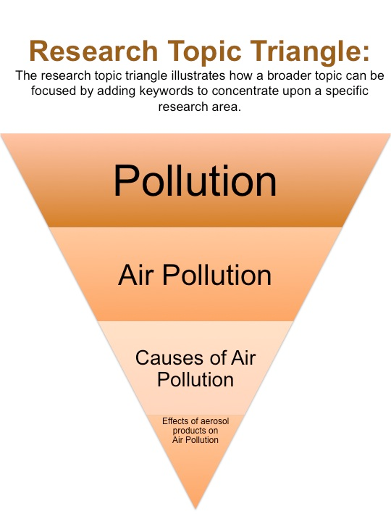
Narrow Down Your Topic
  Your topic should pass the 3-question test:
    Does it interest me?
    Do I have something to say about it?
    Is it specific?

Slide 6
EDUCATION
________________________________
________________________________
________________________________
Practice Topics
1. Culture
2. Festivals
3. Environment
4. Happiness

Slide 7
Explore Your Topic
Pre-writing Techniques:
  Free writing
  Brainstorming
  Listing
  Clustering/Mapping
  Outlining
Notes:
Pre-writing is an informal process that allows you to explore ideas as they occur to you.
There are five main strategies for getting started on any writing assignment:
1. Free-writing
2. Brainstorming
3. Listing
4. Clustering
5. Outlining

Slide 8
Free-Writing
Freewriting is just what it says—writing freely
whatever comes into your mind, even before researching about it
Does not require complete sentences, proper spelling, or correct punctuation and grammar
About 10 to 15 minutes to write everything that comes to mind even if it doesn’t necessarily make sense yet.
Example

Slide 9
Brainstorming
  ….. is creating a list of ideas in response to a problem or question.
  ideas generated by brainstorming don’t need to be related to each other; they only need to be related to the problem at hand.
  Two main ways of brainstorming:
Posing and answering questions about a problem or topic: Who? What? Where? When? Why? How?
Gathering a list of ideas related to the problem or topic.
Example

Slide 10
Listing
Listing is a process of generating a lot of information within a short time by generating some broad ideas and then building on those associations for more detail.
Jot down all the possible terms that emerge from the general topic you are working on.
Simply write down as many possibilities as you can.
Example

Slide 11
Clustering
What is it?
Clustering utilizes a visual map to shape ideas and explore how those ideas relate to each other.
Helpful tip: When you cluster, your topic goes in a bubble in the middle of the page. From there, your ideas expand to form a spider-web visual.
Example

Slide 12
Outlines
Especially for long papers, outlines can be quite detailed, but even a short outline can be helpful in giving the writer ideas and a sense of organization for an essay.
E.g.
After looking carefully at the photograph of a refugee mother, Ali feels that he has identified three important ideas that might be the focus of his essay. He writes down these ideas:
The family is living in severe poverty.
The mother is trying to care for her family.
The mother is determined not to be defeated by her difficulties.

Slide 13
Writing your Thesis Statement
A thesis statement generally consists of two parts:
your topic, and the main point: the analysis, explanation(s), or assertion(s) that you are making about the topic.
OR
Thesis statement = Narrowed topic + main point
Euthanasia is suicidal, it should be banned.
Narrowed topic main point
________________________________
Example

Slide 14
Three Point Thesis Statement
  A 3-point thesis statement is a coherent statement that integrates the three essential components of a standard thesis statement.
  includes a topic, an assertion, and reasons justifying the claim.
  Thesis statement = Narrowed topic + Main point + First supporting reason/idea + Second supporting reason/idea + Third supporting reason/idea
Example

Slide 15
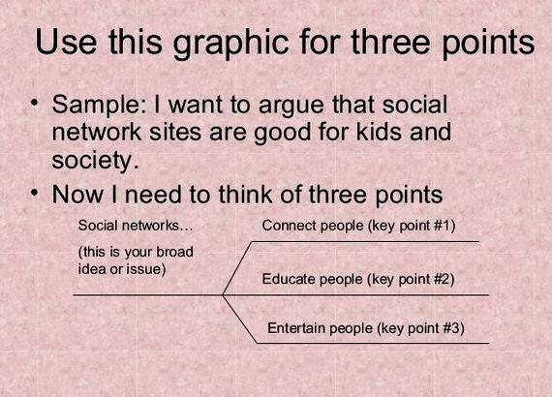

Slide 16
Practice
Writing Prompt:
Should students be allowed to eat snacks in the classroom? Why or why not?
Thesis Statement:
Students (should / should not) be allowed to eat snacks in the classroom because
______, _________, and ________.
Writing Prompt:
2. Write an essay explaining why a decision you made was the right one?
Thesis Statement:
My decision to______________ was the right one because___________,
___________, and ____________.

Slide 17
Practice
Add Thesis Statement: .
Topic Sentence Paragraph 1:___________________________________________
__________________________________________________________________
Topic Sentence Paragraph 2:___________________________________________
__________________________________________________________________
Topic Sentence Paragraph 3:___________________________________________
__________________________________________________________________

Slide 18
Practice :
Instructions: Read the outline and write a thesis statement.
Topic: Young people should pay attention to politics.
Young people are intelligent enough to understand what’s going on.
Politics affects everyone’s lives, including young people’s.
Paying attention to politics now will help young people to be informed citizens when they are old enough to vote.
Thesis Statement

Slide 19
II. Drafting - Putting your ideas and thoughts together in sentences and paragraphs.
organize all of your notes from your pre-writing into separate paragraphs.
The paragraphs should support your introduction and your thesis statement.
Everything needs to flow smoothly.
The conclusion, or "end", of your essay should sum up what you have said, without repeating. It should give the reader some final thoughts on the topic you are writing about.
III. Revising is rewriting or rearranging sentences to make sense.
making decisions about how you want to improve your writing
looking at your writing from a different point of view
picking places where your writing could be clearer, more interesting, more informative and more convincing.

